Slide 1
Association of Indians for Self-Determination in Healthcare Annual Board Meeting
July 25, 2026
Navajo Healing Navajo

Slide 2

Agenda
About Navajo YHC
YHC Virtual Tour
Navajo Nation & Axiom Care Partnership
YHC Team
Cultural Grounded & Family Focused Care
Patient Flow Chart & Admissions Process
Axiom Care Programs & Facilities
Contact Information & Q & A

Slide 3
Land Acknowledgement
The Yideeską́ądi Hózhǫǫ́jí Center and Axiom Care acknowledge the ancestral and contemporary homelands of the Akimel O’odham and Piipaash peoples. As guests on these lands, we recognize our responsibility to be good relatives and to uphold our role as caretakers by providing compassionate, culturally grounded, and effective care for Indigenous people seeking healing from addiction. Through the Yideeską́ądi Hózhǫǫ́jí Center, we offer a healing experience rooted in Diné values and honor traditional practices, including the Navajo Wellness Model, healing circles, GONA principles, and evidence-based care aligned with SAMHSA best practices. We further affirm our respect for the sovereignty of Arizona’s twenty-two Tribes and acknowledge the many Indigenous relatives from across Turtle Island who now call Hoozdo (Phoenix) home.

Slide 4
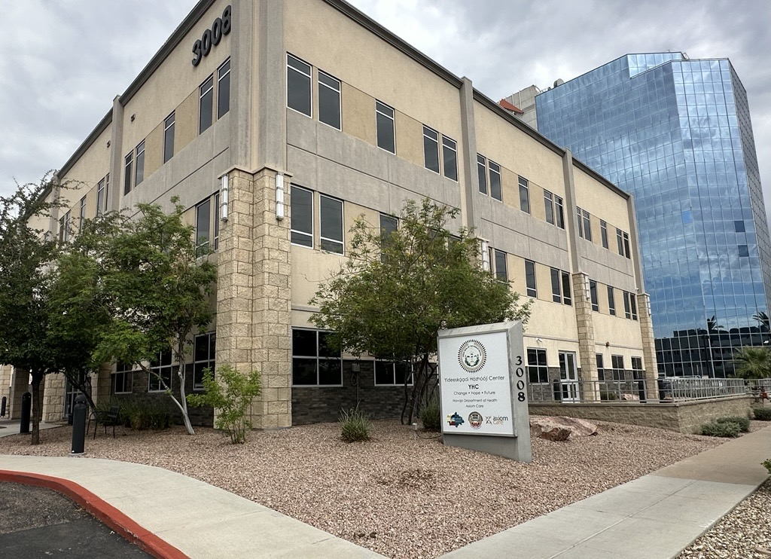
Navajo YHC
Yideeską́ądi Hózhǫ́ǫ́jí Center (YHC) is a Navajo Nation-owned residential substance use treatment facility in Phoenix dedicated to serving members of the Navajo Nation and their families located at 3008 N. 3rd Street in Central Phoenix.
Virtual Tour: YHC Facility

Slide 5

Navajo Healing Navajo
YHC was established to ensure access to effective, culturally relevant care for members of the Navajo Nation and their families, addressing intergenerational trauma through a trauma-informed care model.
YHC is operated in partnership with the Navajo Department of Health (NDOH), the Navajo Division of Behavioral and Mental Health Services (DBMHS) and Axiom Care.

Slide 6
Establishment of Yideeską́ądi Hózhǫ́ǫ́jí Center
2024
Navajo Department of Health posts RFP.
March 2025
NDOH purchased building.
Partnership Established
Axiom Care contracted as operating partner.
July 2026
92-bed residential treatment capacity.
DBMHS established program to address critical need.
Contracted & credentialed with AHCCCS, AIHP and insurances partners.
Axiom Care awarded RFP.
Over 386 Navajo relatives served.
Licensed by ADOH
Joint Commission accredited.
90 Navajo relatives have successfully completed the program.

Slide 7
Ownership vs. Operational Roles
Owns Yideeską́ądi Hózhǫ́ǫ́jí Center
Established program through DBMHS
NDOH & DBMHS (Program Authority)
Navajo focused residential treatment facility
Built on “Navajo Healing Navajo” model
Axiom Care (Operator)
Provides facility operations & Day-to-day management
Clinical staffing & Program Delivery
Provides program oversight & governance
Navajo Nation (Ownership)

Slide 8
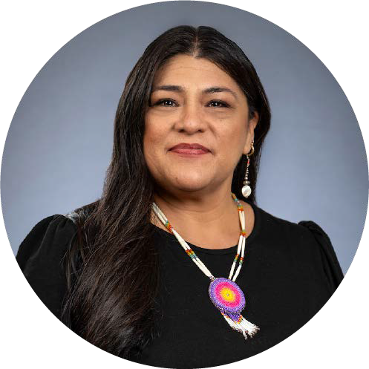
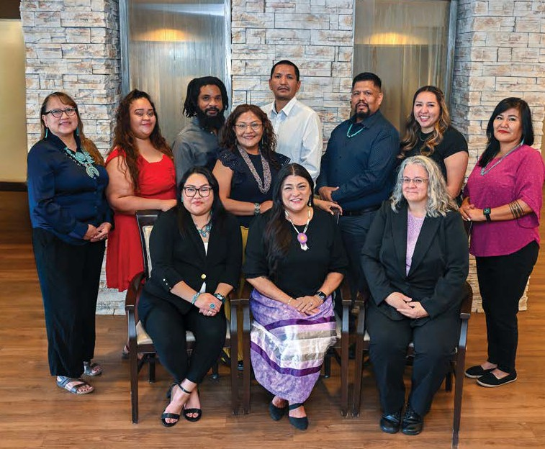
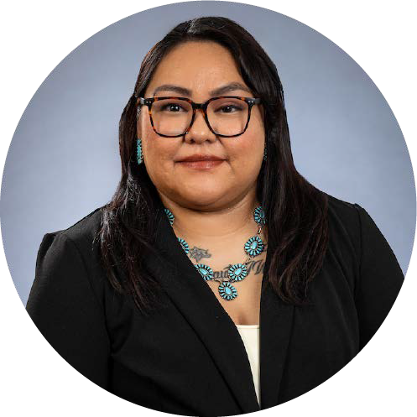
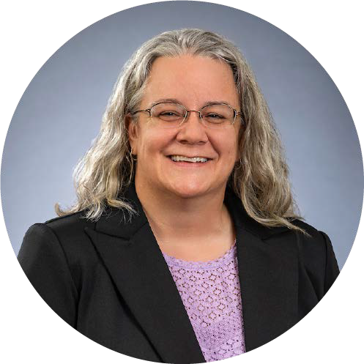
YHC Team
Andrea Klimas, MS, LIAC
(Mexican/Oglala Lakota) Executive Director – Indigenous Programs
Heather Johnson
(Diné/White Mountain Apache)
Operations Manager
Leslie Perez-Whitehead, MSW, LCSW, CCTP
Clinical Director

Slide 9
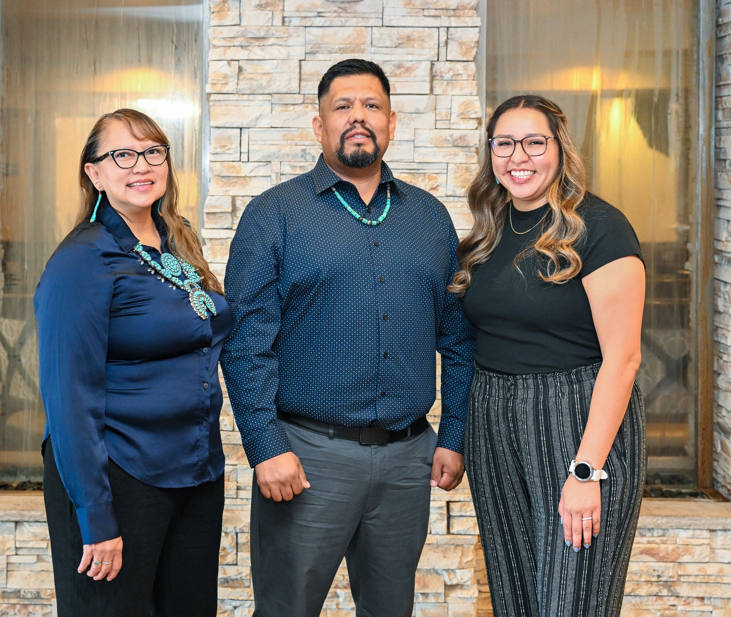
YHC Team
Staff On-Site
Clinical Supervisor
Registered Nurse (RN) & Practical Nurse (LPN)
Clinicians
Traditional Practitioners
Behavioral Health Technicians
Peer Recovery Specialists
Case Managers

Slide 10
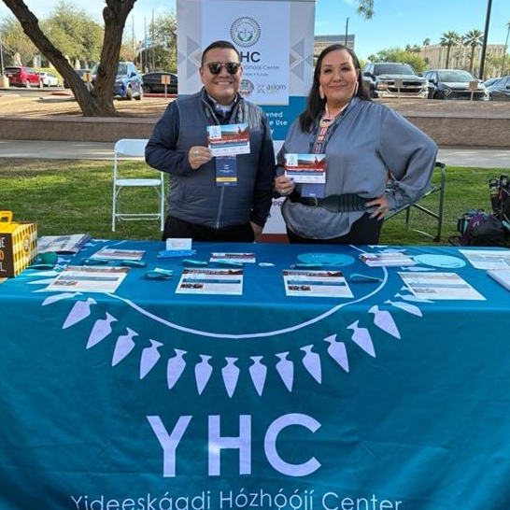
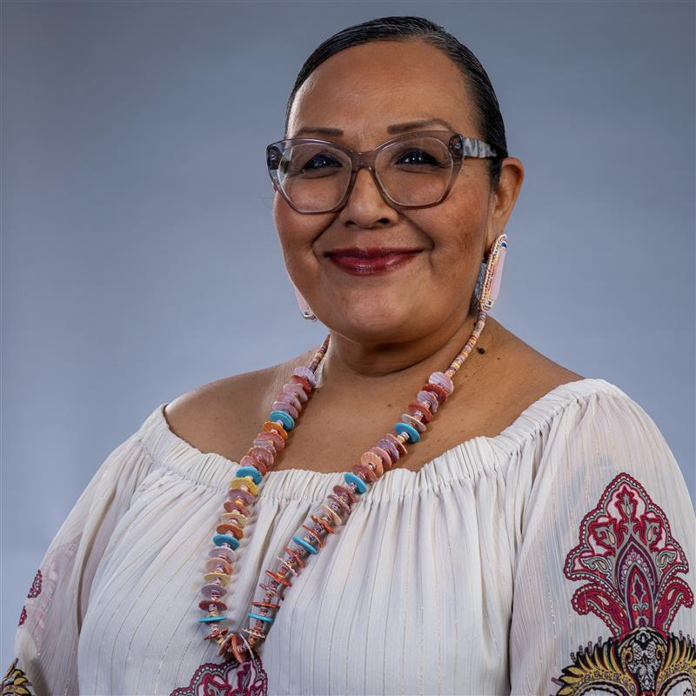
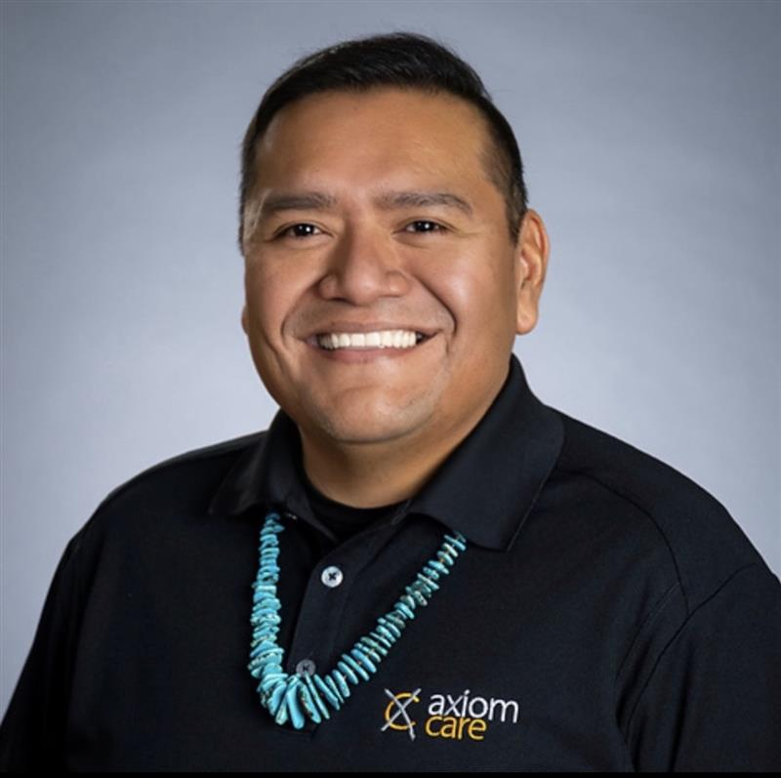
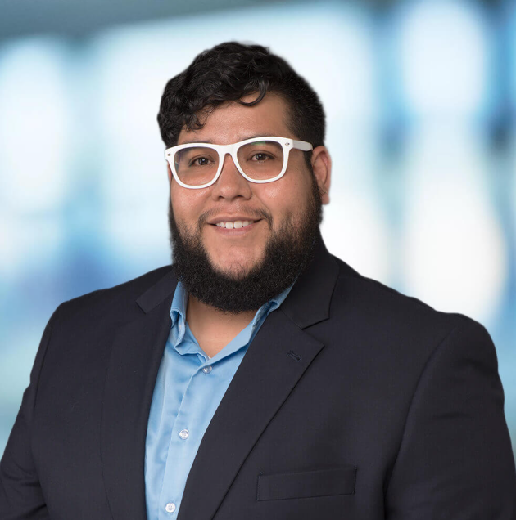
YHC Outreach & Admissions
Larita Anderson
(Hopi/Diné)
Tribal Liaison
(Navajo Nation)
Levi Long, M.S.
(Diné)
YHC Partnerships & Communications Specialist (Phoenix)
Estevan Pina
Axiom Director of Admissions

Slide 11
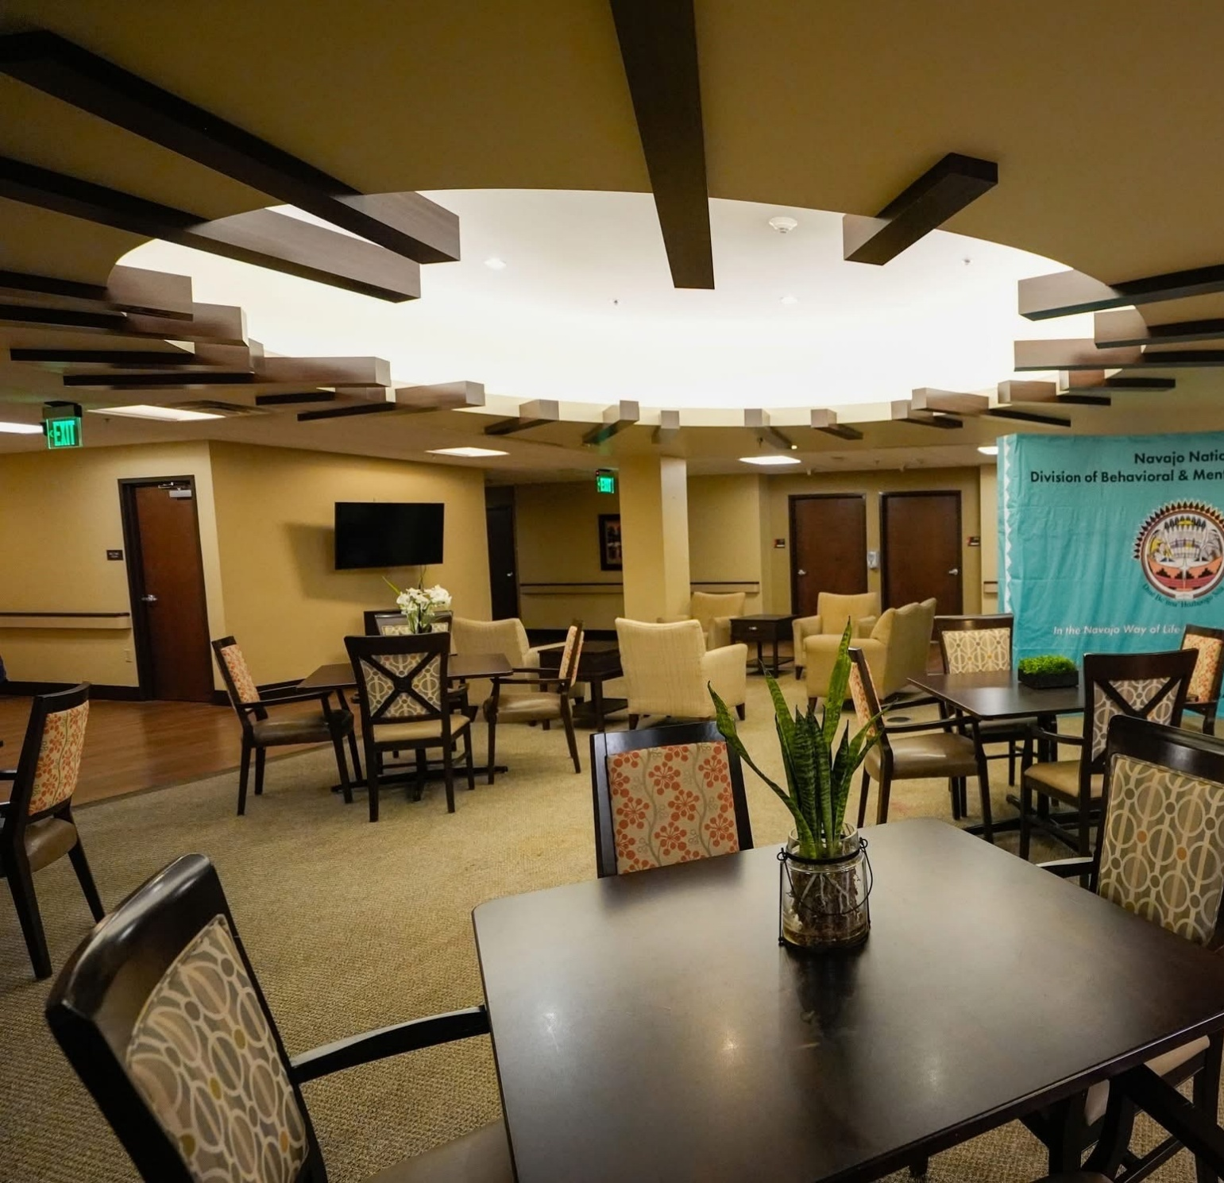
Program Elements
The center opened in September 2025 with 44 beds, with phase two expansion to 92 beds in November. Upon completion of construction in 2026, YHC will include a healing garden, ceremonial hogans, a resident fitness center and a new lobby with staff offices.
The 60-to-90-day YHC curriculum integrates traditional knowledge such
as healing circles, GONA Principles, the Navajo Wellness Model and
evidence-based care with SAMHSA best-practices, offered through
individual counseling, case management and group and family counseling.
Our program follows the Hózhǫ́ way, restoring balance, harmony, and beauty in all areas of life. Guidance and support from hataałii (medicine people) and kéyah (clan) members are centered in the YHC model for healing.

Slide 12
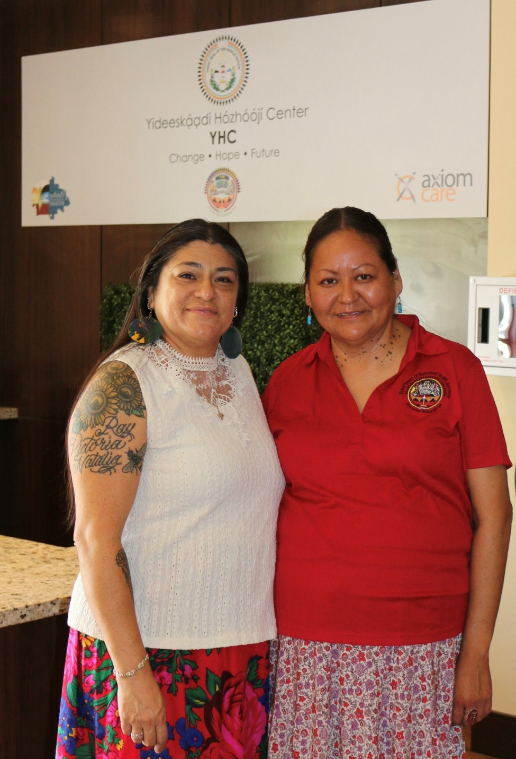
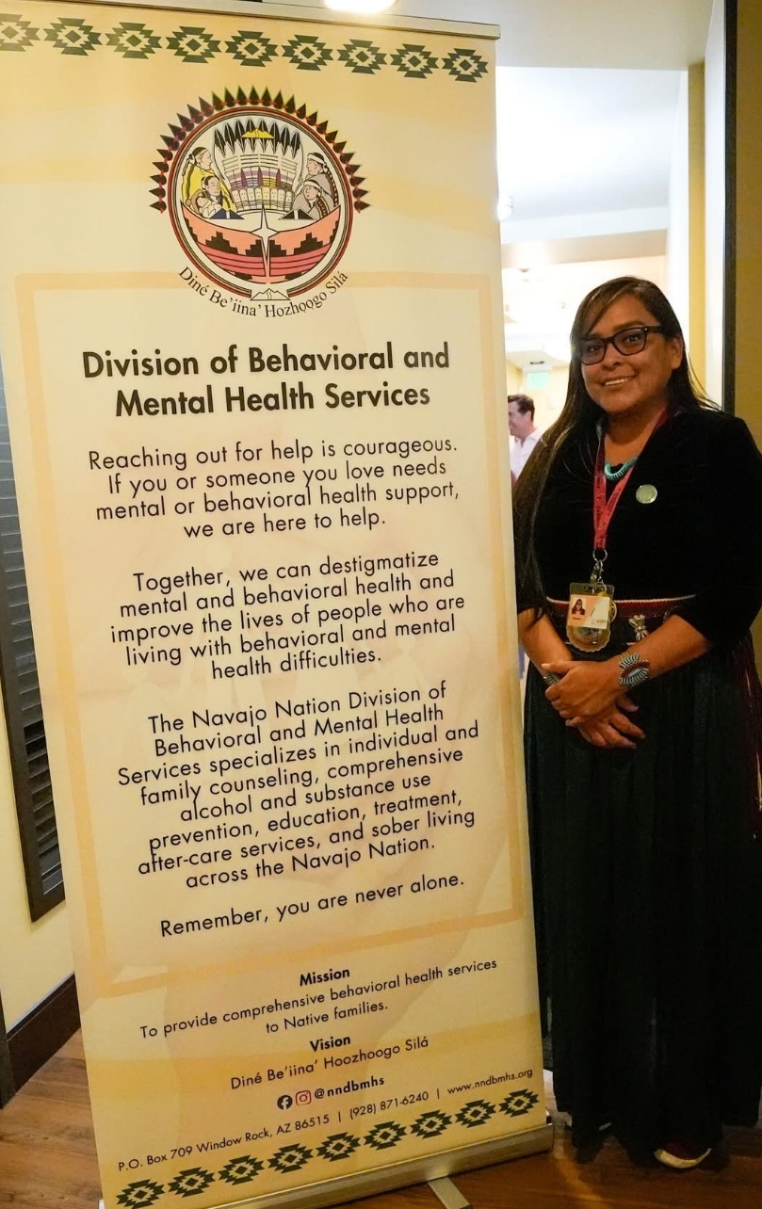
Culturally Grounded Care
YHC combines urban treatment services with the cultural expertise of DBMHS practitioners to provide holistic, culturally rooted care.
This collaborative treatment model provides holistic healing and family support through evidence-based treatment models, including SAMHSA best practices in compliance with Joint Commission structure and Diné cultural traditions.
Groups 6 times a day
H&l meetings
Weekly individual counseling session with a Clinician
Biweekly case management
Monthly treatment plan review meetings
Meetings on site and when appropriate, off-site

Slide 13
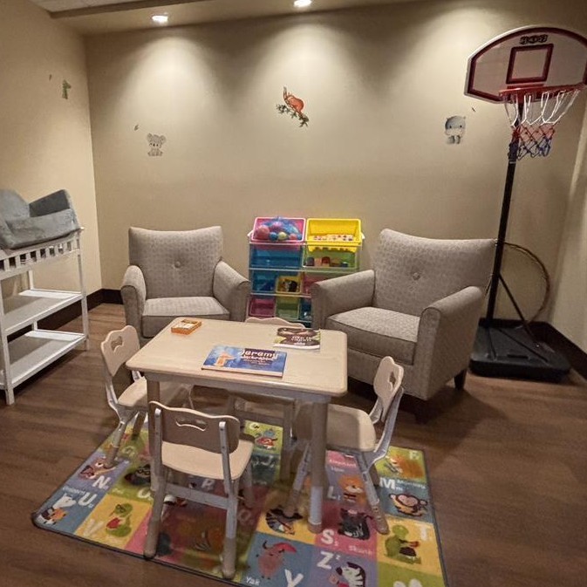
K’é Centered Space
The YHC program is designed to keep families together by welcoming children to live with their parent or parents during treatment.
On-site weekday childcare ensures parents can fully engage in both group and individual counseling.
Family therapy sessions will be incorporated to support new sober parenting styles and strengthen familial bonds.

Slide 14
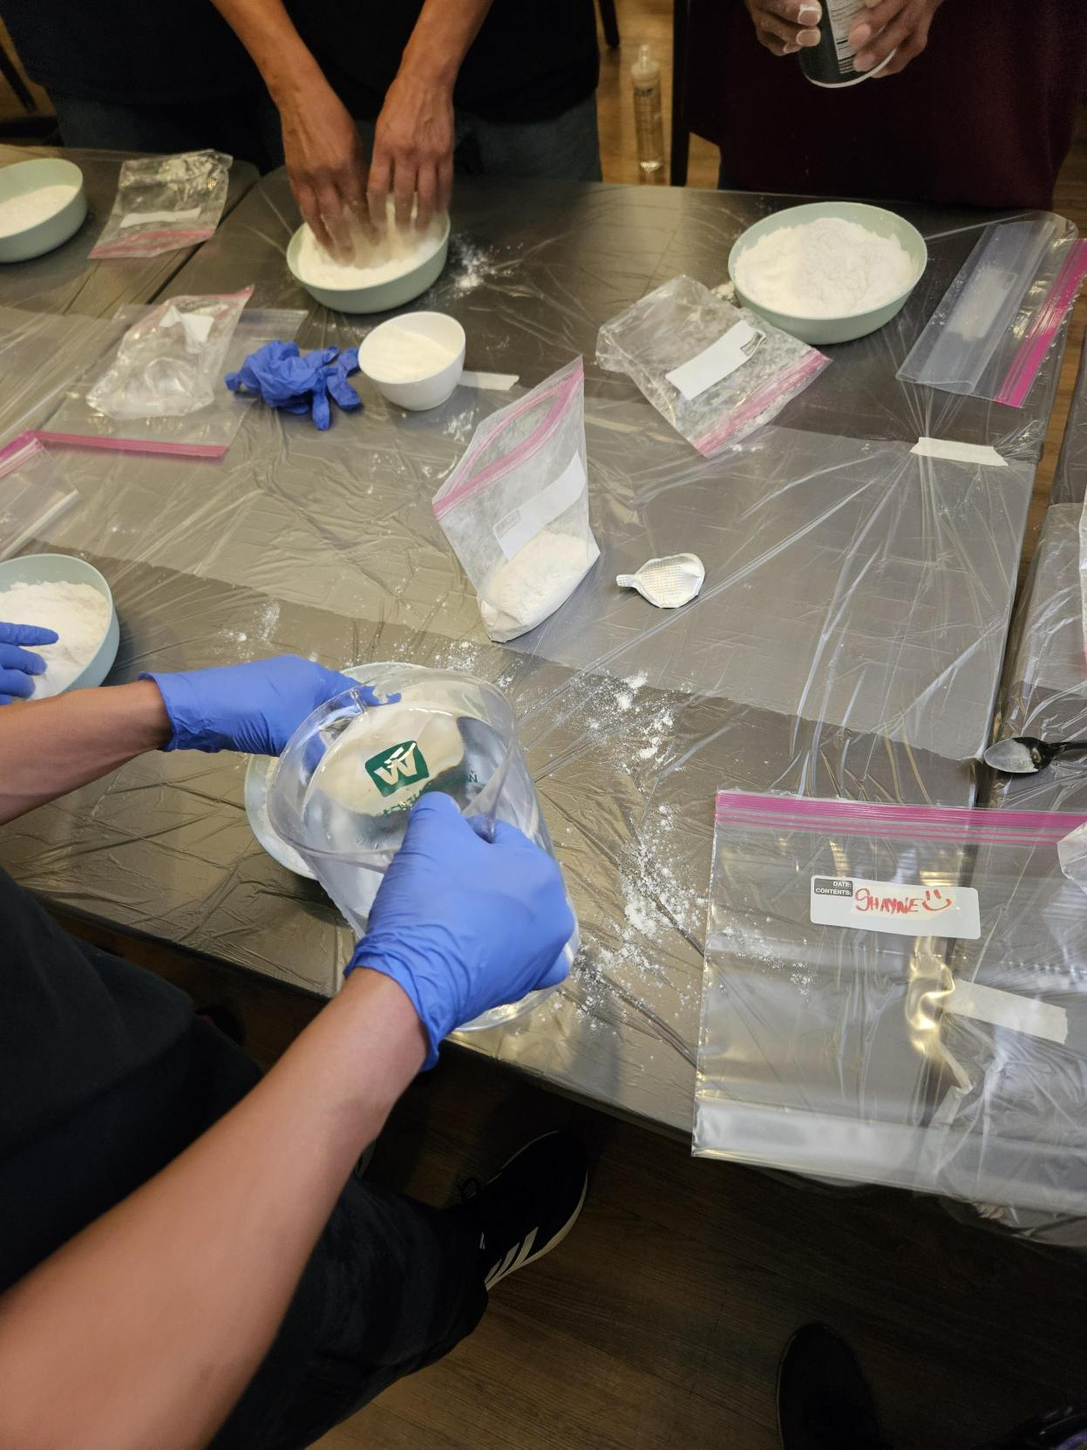
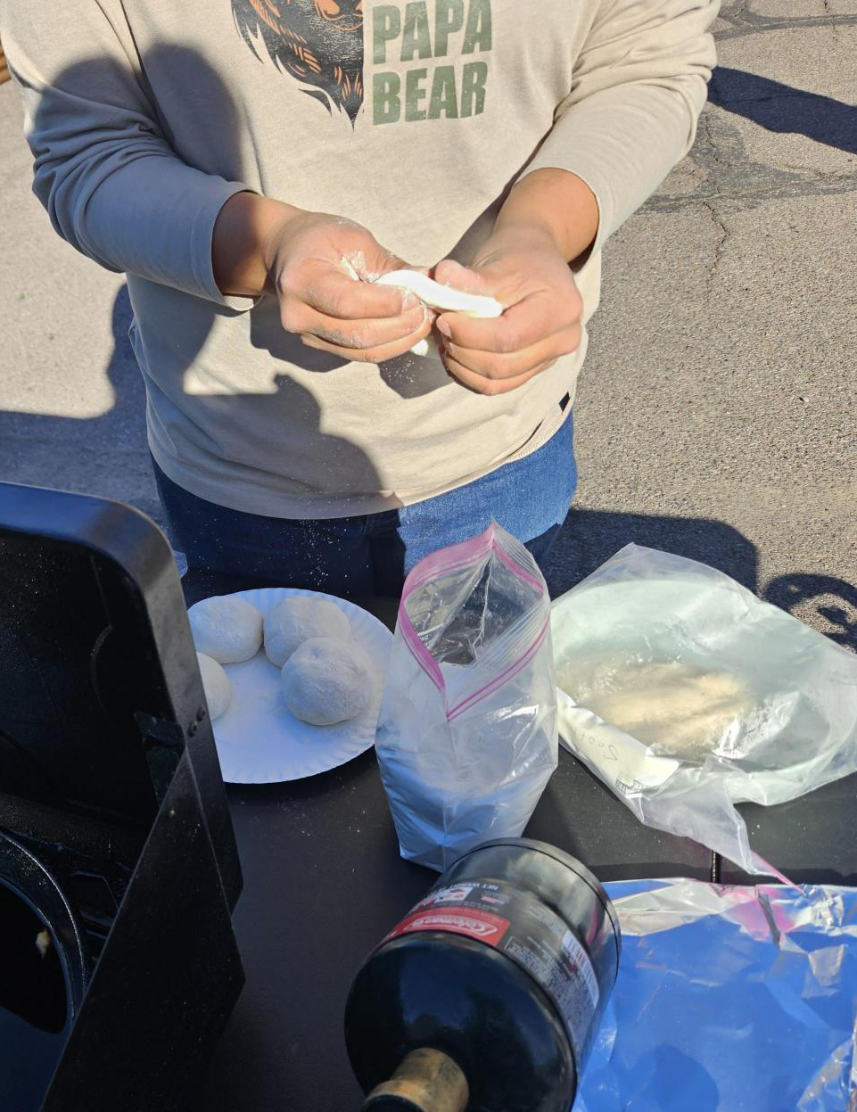
Program Elements
To address the need for transportation, which is often a barrier to treatment, shuttles arranged by Axiom Care, will transport residents from home to treatment and back, whether home is on the Navajo Nation or in the Phoenix area.
YHC works with all AHCCCS providers, but no Navajo Nation member will be turned away due to their insurance status.
YHC has an on-site Navajo Nation Tribal Regional Behavioral Health Authority (TRBHA) representative to help coordinate care.
YHC and Axiom Care will offer workforce training tailored for Navajo Nation members that will prepare individuals to become substance use treatment professionals, including roles such as peer support specialists and behavioral health technicians.

Slide 15
Patient Flow Chart
Patient Flow Chart
Referrals
  Received via admissions phone, email, provider or family referral
Transport
  Urban clients transported by Axiom Care
  Nation clients transported by NEMT partners
Clinical Assessments
  Completed at Axiom Care’s 24/7 Ocotillo Campus
Level of Care
  Detox/ Observation (if necessary) or
  Direct Admission to YHC residential
Admission to YHC
  Members transported to YHC to begin treatment
Referrals
  Received via admissions phone, email, provider or family referral
Transport
  Urban clients transported by Axiom Care
  Nation clients transported by NEMT partners
Clinical Assessments
  Completed at Axiom Care’s 24/7 Ocotillo Campus
Level of Care
  Detox/ Observation (if necessary) or
  Direct Admission to YHC residential
Admission to YHC
  Members transported to YHC to begin treatment
1. Referral Received
2. Transport Coordinated
3. Clinical Assessment
4. Level of Care Determined
5. Admission to YHC Residential
1. Referral Received
2. Transport Coordinated
3. Clinical Assessment
4. Level of Care Determined
5. Admission to YHC Residential

Slide 16
RECOVERY BEGINS TODAY: WHAT TO EXPECT
Taking the first step toward recovery can feel overwhelming, but you're not alone. Axiom Care's compassionate Admissions team is here to guide you every step of the way.
Call us at 928-212-CARE (2273). We're here to listen.
Complete a brief pre-screening assessment with one of our experienced Admissions Representatives.
Review your options together. Based on your assessment, we'll talk through the recommended program and answer any questions.
Get the details. We'll walk you through what to bring, what to expect, and how to prepare.
How long is the program? A person's length of stay is determined by the level of care and their progress on their service goals.
Schedule your intake appointment over the phone at a time that works for you.
Need a ride? We can arrange transportation. We will pick up the client and take them to our Apache Junction site for observation. Once completed, clients can be placed into detox if needed or they can be transferred to YHC.

Slide 17
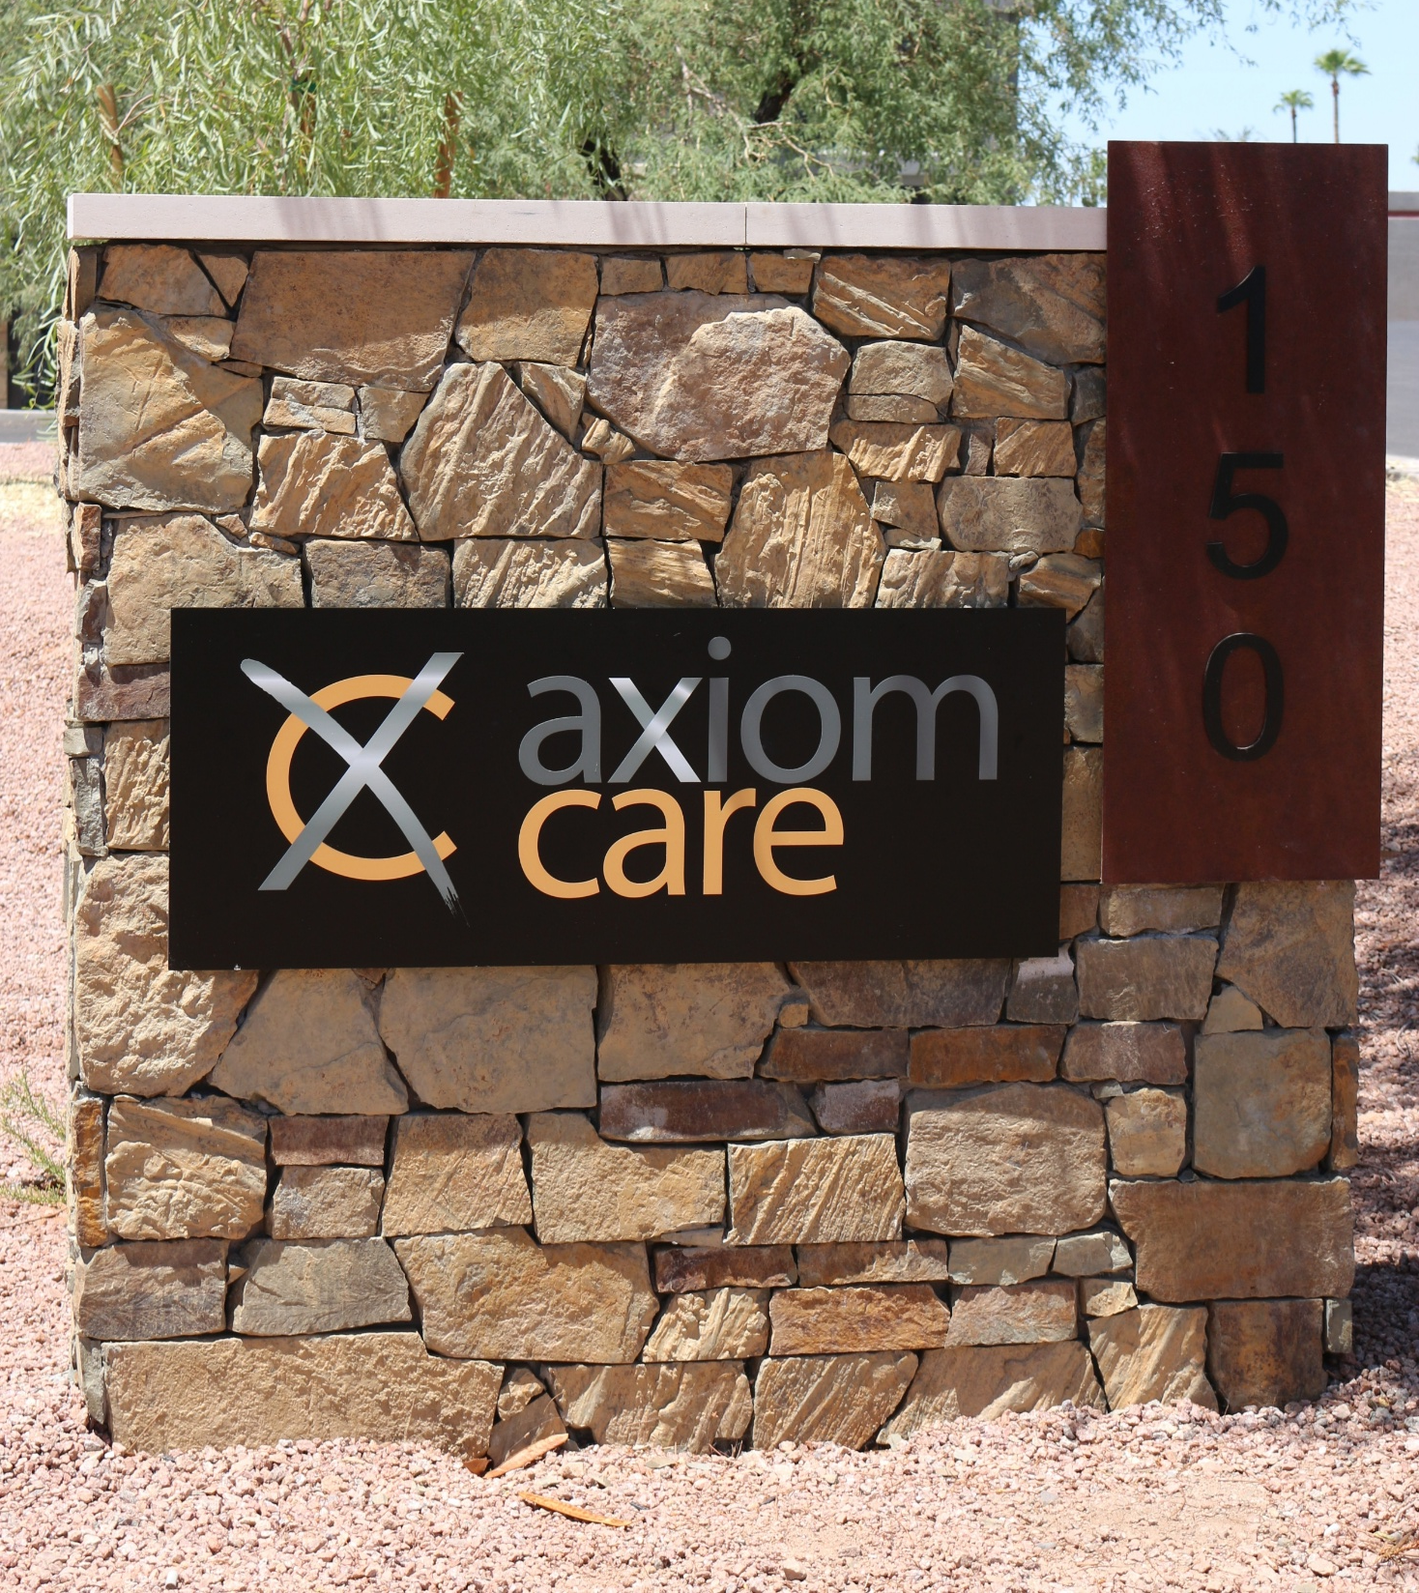
Axiom Care
Founded in 2012, Axiom Care is a Phoenix-based provider of substance use treatment and recovery housing.
Dedicated to transforming lives, Axiom Care serves financially vulnerable and justice involved individuals providing a pathway to a brighter life. Axiom Care is led by CEO, Danelle Trottier.
Axiom Care offers comprehensive services encompassing multiple levels of care, including drug and alcohol detoxification, residential treatment, intensive outpatient treatment, medication assisted treatment, supportive housing, integrated care, and re-entry support.

Slide 18
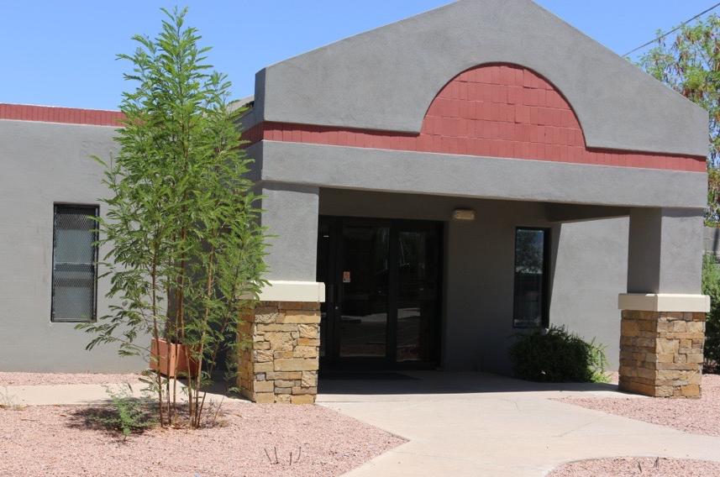
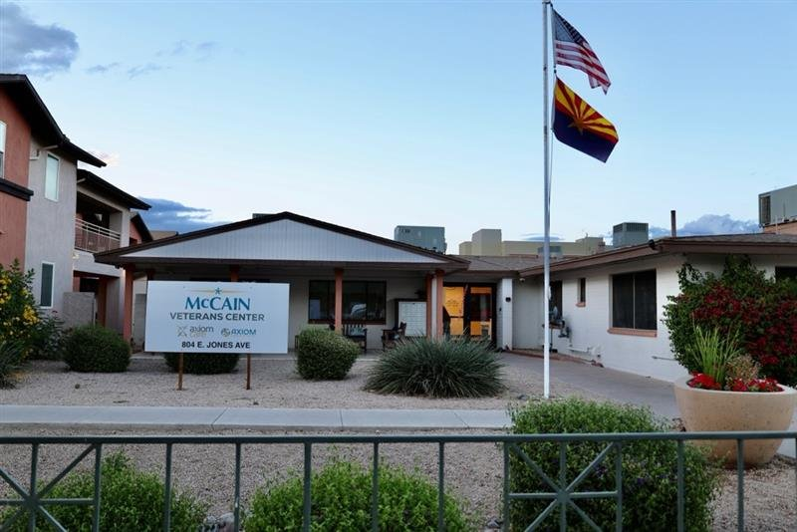
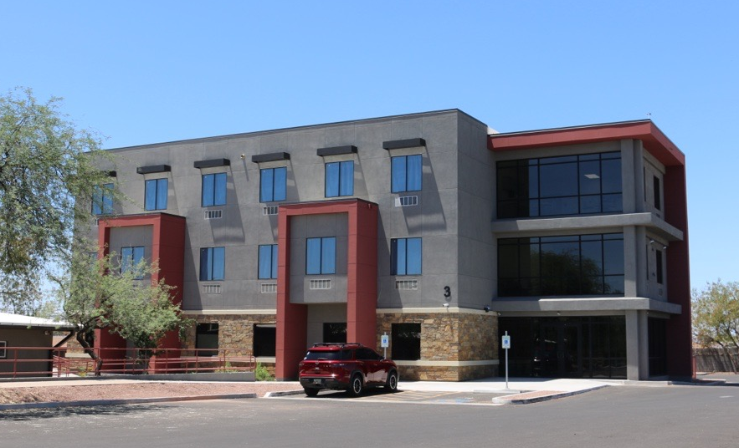
With a commitment to quality and care, Axiom Care serves more than 4,000 Arizonans annually through our Arizona Department of Health Services (AZDHS) credentialed facilities: which include:
Ocotillo Campus of Care - Apache Junction
  24-chair Observation Unit –Immediate SUD stabilization, Medical clearance & Placement
  27-bed Inpatient Detox Center – Medically Supervised Withdrawl, 4-7 Days
60-bed Residential Substance Use Treatment Center
John McCain Veterans Center – Victory Place Campus
A 60-bed transitional housing program.
Designed to serve Veterans navigating challenges related to substance use disorders, mental health conditions, trauma and homelessness
Currently serves as step down option for YHC alumni
Justice Involved & RCBM (Residential Community Behavior Modification)
Almeria (Women), Del Sol (Men) & Whitton (24-bed Men)
Parolees & Court Ordered

Slide 19
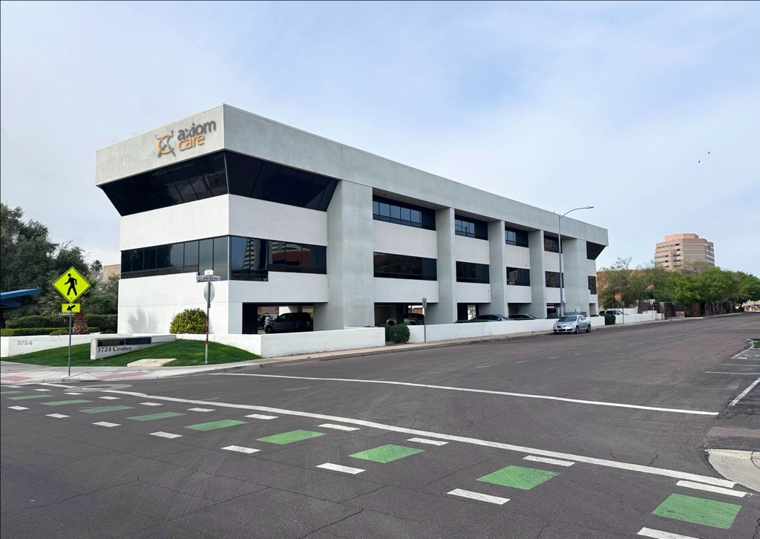
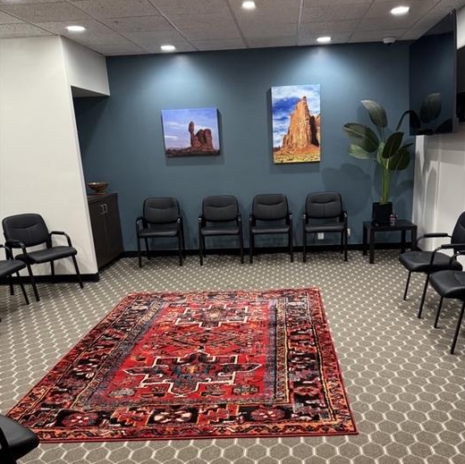
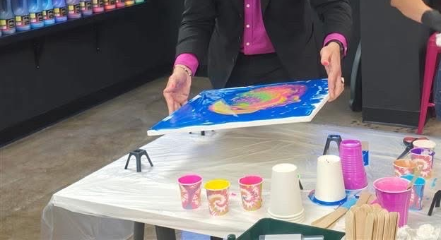
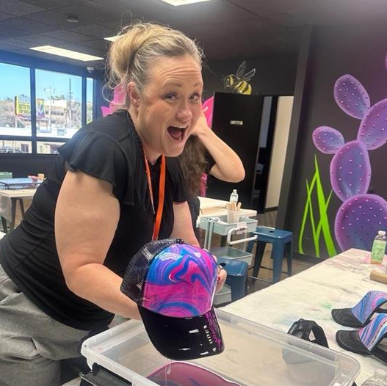
Mofford Center – Integrated Clinic at 2742 N. 3rd Street in Phoenix opened in Spring 2025. Offers group and individual substance use treatment, outpatient behavioral health services, peer support and case management and workforce development.
Indigenous Program – Culturally response services & healing
Case Management for Indigenous relatives
Art of Our Soul Studio for art therapy integration

Slide 20

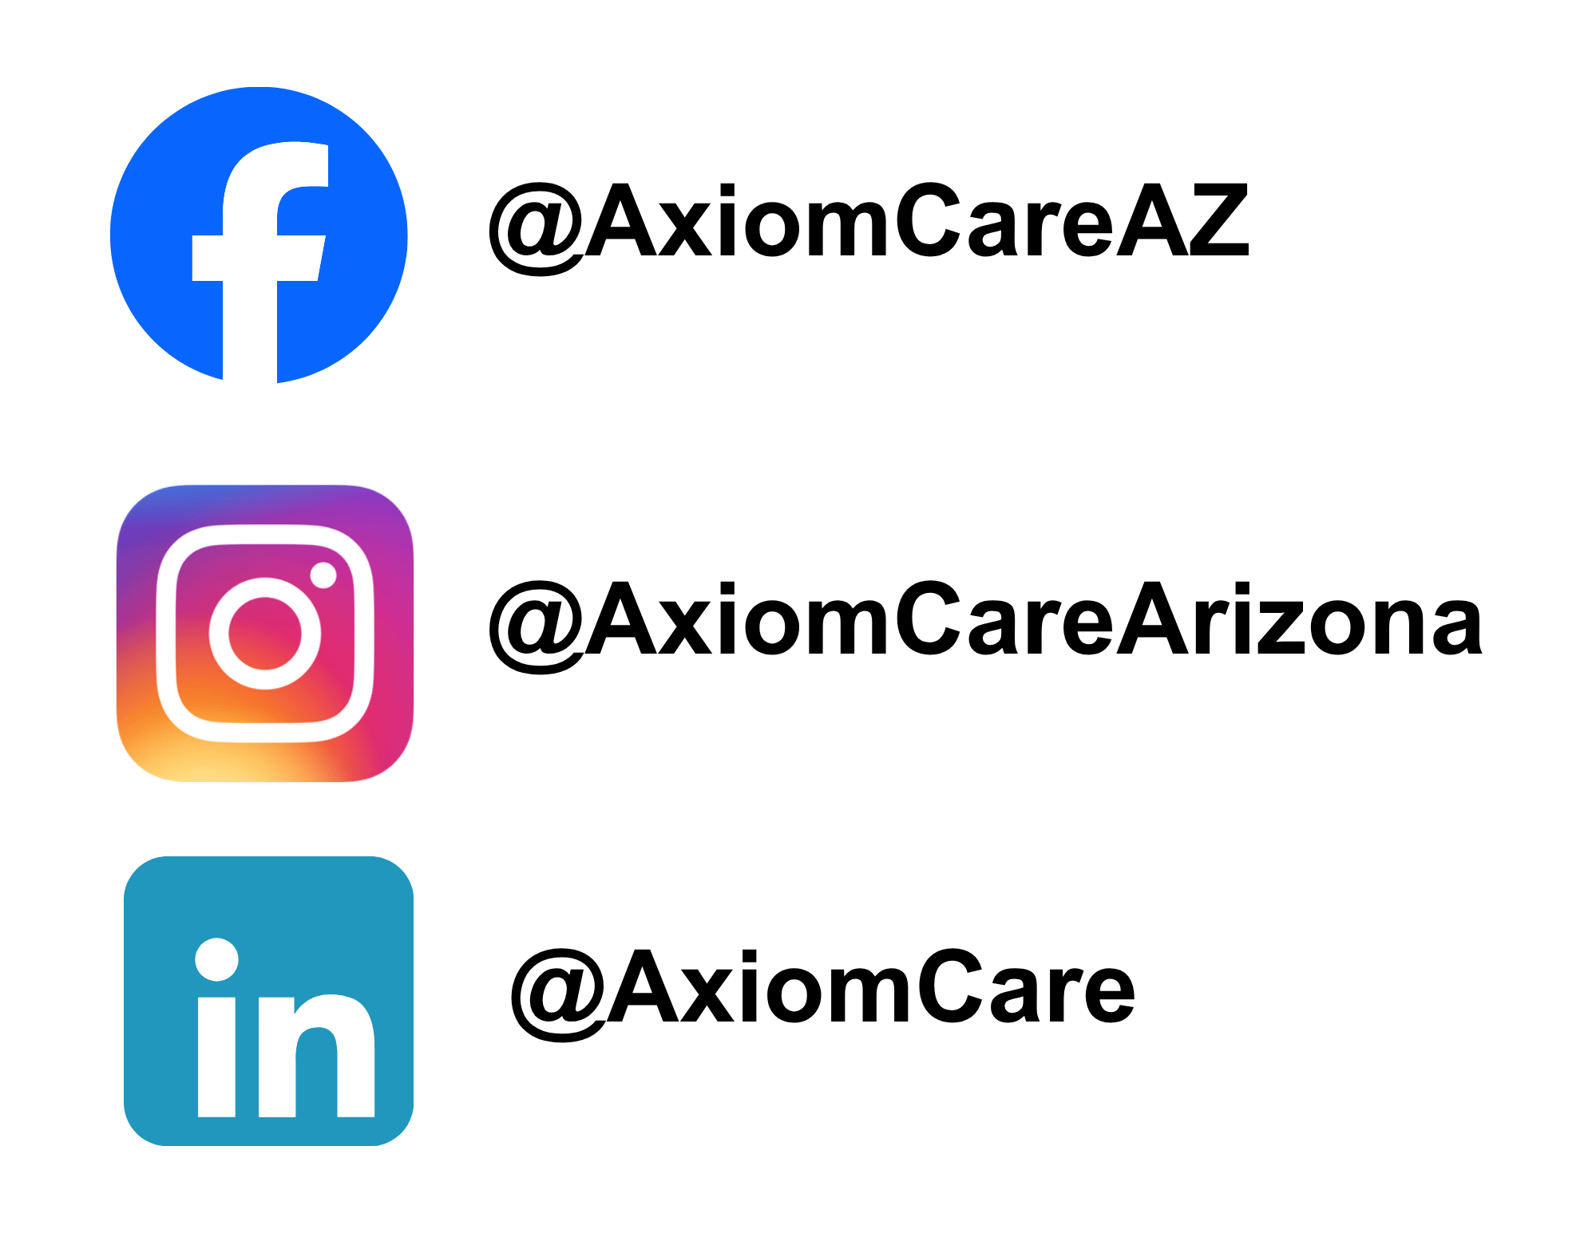
Admissions:
928-212-CARE (2273)
Website:
Navajo-YHC.com
Contact
Address:
3008 N. 3rd Street
Phoenix, AZ 85012
LAnderson@AxiomCareOfAZ.com
(928) 660-7342
LLong@AxiomCareOfAZ.com
(602) 616-6968

Slide 21
